Slide 1
Re-Reflecting The Sun
How New Low-Cost Legislation Can Combat Climate Change and Reduce Energy Costs
Sarah, Micah, Ben, Rachel & Rachel

Slide 2
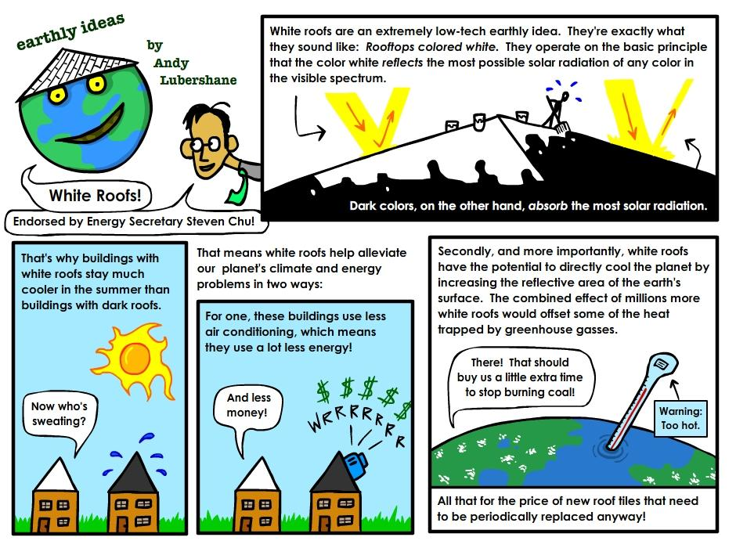
The Science of Cool Roofs
Notes:
http://www.worldchanging.com/EarthlyIdeas-WhiteRoofs.jpg

Slide 3
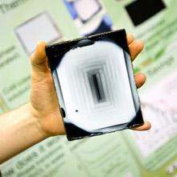
Solar Panels and White Roofs
Solar panels and white roofs go hand in hand!
enhanced reflectivity= more efficient PV (solar) panels
Color changing solar panels
save on heating in the winter
and cooling during the
summer!

Slide 4
Proposed Policy
3 pronged approach:
Mandate, incentivize and subsidize
Mitigate costs
Create change as quickly and efficiently as possible

Slide 5
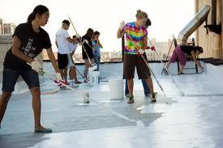
Mandate
when a structure or roadway is reroofed or repaved the new coating must be of a specified reflective property (opt-out tax goes to tax subsidies)
Includes municipalities and corporations
Reroofing
can be fun!

Slide 6
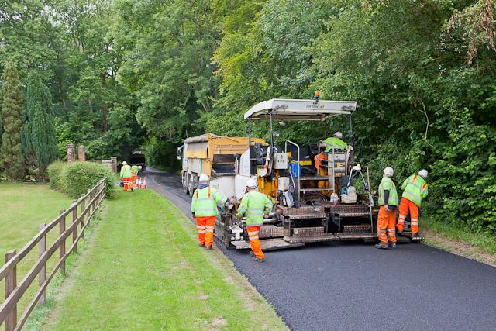
Incentivize
mandate gives paint/pavement manufacturers incentive for making more reflective materials

Slide 7
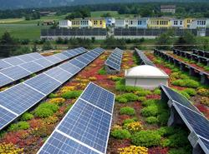
Subsidize
Opt-out tax goes to tax subsidies for installing solar panels or green roofs

Slide 8
Winners and Losers
Losers
Arid urban areas
affects rainfall in drier areas
Winners
Homeowners/ residents of the area
save $ on air conditioning
reduces smog (better air quality)
Paint companies
potential to increase jobs
the Environment!
reduced carbon emissions
increased albedo effect

Slide 10
Actual Reduction
For United States:
If all of the roofs in the United States painted their roofs white, it would take only 20 years before the energy savings equaled the greenhouse emissions we produce annually
If we paint 5% every year:
we will be done by 2030!
save 24 billion metric tons of CO₂ (the amount of total emissions for 2010)
If each household in the U.S. saves $100 => $5,000,000,000 for the ENTIRE U.S.
For China:
Painting all the rooftops of homes white could offset 6,753,080,000 tons of carbon dioxide per year
Notes:
http://www.nytimes.com/imagepages/2009/07/30/science/30degrees.graphic.ready.html

Slide 11
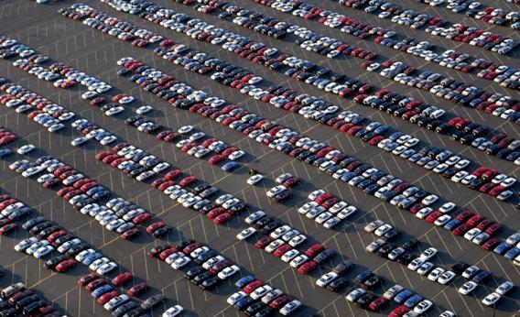
Actual Reduction
US:
Initial reduction: 24 Gt, Annual rate of 1.2 Gt (for about 20 years)
Roofs and pavements cover 50 to 65 percent of urban areas=> equivalent to getting 300 million cars off the road

Slide 12
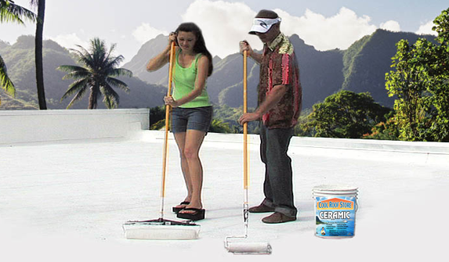
Cost
Cool roofs will not cost the homeowner significantly more, if at all
Will only cost anything when one is reroofing
Increase in costs of cool roofing materials in comparison to regular materials ranges from $0.00 to $0.10 per square foot

Slide 13
Cost
Studies show net annual savings of about $0.50 per square foot with cool roofs
While reroofing a regular roof that is in good condition would be fairly expensive, reroofing a roof that needs repair or replacement with cool roofing is not a significant cost

Slide 14
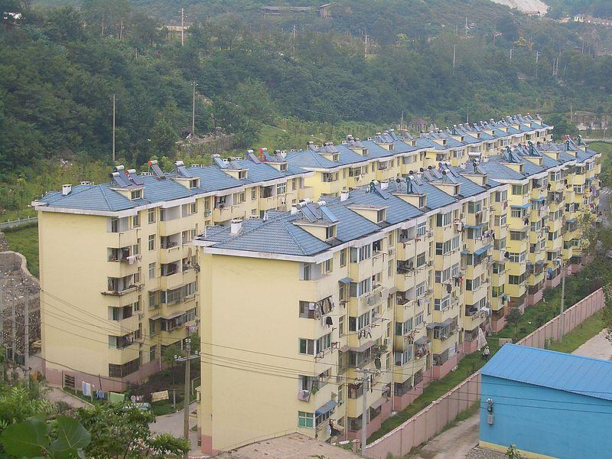
Public Perception
Solar power, like many green initiative practices, is popular in China
The U.S. Government has been active in encouraging the use of environmentally friendly technologies
About 73% of the American
public believe climate
change needs to be dealt
with
62% say they are
willing to pay some costs to
take action
Tieshan solar water heaters

Slide 15
Public Perception
In China, surveys
show up to 94%
approval of climate
change as a high
priority issue
Chinese representatives recently (Jan.) visited Berkeley lab for a cool roof and cool pavement workshop and seminar

Slide 16
Public Perception
The cooling of homes and buildings, meaning less of a need for artificial cooling and less costs for air conditioning
There is a large selection of reflective roof colors, even black

Slide 17
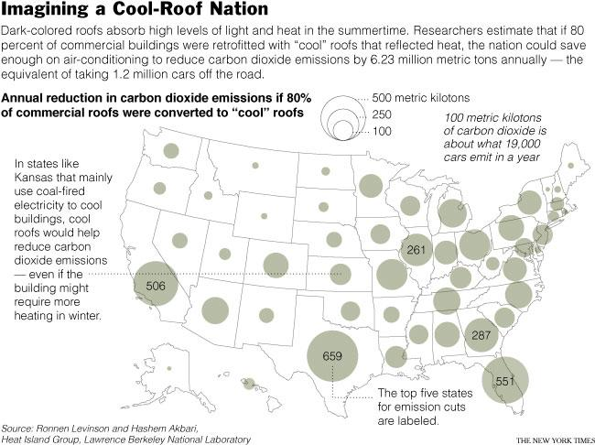

Slide 18
Citations
http://eartheasy.com/blog/2012/07/white-roofs-offer-a-simple-strategy-to-help-combat-global-warming/
http://whiteroofproject.org/research/
http://iopscience.iop.org/1748-9326/7/3/034026/pdf/1748-9326_7_3_034026.pdf
http://www.scientificamerican.com/article.cfm?id=cool-roofs-may-have-side-effects-on-regional-rainfall
http://antaressunstar.com/wp-content/uploads/2012/08/slide1.jpg
http://newscenter.lbl.gov/news-releases/2010/07/19/cool-roofs-offset-carbon-dioxide-emissions/
http://www.psmag.com/blogs/news-blog/white-roof-isnt-always-right-roof-3711/
http://www.ornl.gov/sci/roofs+walls/facts/CoolCalcEnergy.htm
http://www.globalcoolcities.org/wp-content/uploads/2010/12/White-Roofs-Cool-World-2ppNewCntct.pdf
http://www.globalcoolcities.org/wp-content/pdf/coolcoloredroofs_2005.pdf
http://blogs.reuters.com/great-debate/files/2011/07/IMG_2500a.jpg
http://www.globalcoolcities.org/wp-content/pdf/coolcoloredroofs_2005.pdf
http://www.globalcoolcities.org/wp-content/uploads/2012/08/Akbari-Long-Term-Albedo-Changes-in-Cities.pdf
http://www.iea.org/publications/freepublications/publication/buildings_roadmap-1.pdf
http://www.scientificamerican.com/article.cfm?id=chinas-big-push-for-renewable-energy
http://apps1.eere.energy.gov/news/news_detail.cfm/news_id=12065
http://eetd.lbl.gov/news/article/30571/chinese-delegation-attends-cool-roof-project-meeting
http://www.c2es.org/docUploads/AmericanClimateAttitudest_May2011.pdf
http://www.guardian.co.uk/environment/2009/jul/30/climate-change-us
http://www.documents.dgs.ca.gov/bsc/calgreen/2010_ca_green_bldg.pdf
http://www.epa.gov/heatisland/mitigation/coolroofs.htm
http://www.sciencedirect.com/science/article/pii/S2212095512000077
http://whiteroofproject.org/how-we-can-curb-climate-change/
http://www.worldwatch.org/maturing-environmental-movement-takes-uniquely-chinese-approach
http://www.nytimes.com/2012/07/05/world/asia/chinese-officials-cancel-plant-project-amid-protests.html
http://newscenter.lbl.gov/news-releases/2010/07/19/cool-roofs-offset-carbon-dioxide-emissions/

